Slide 1
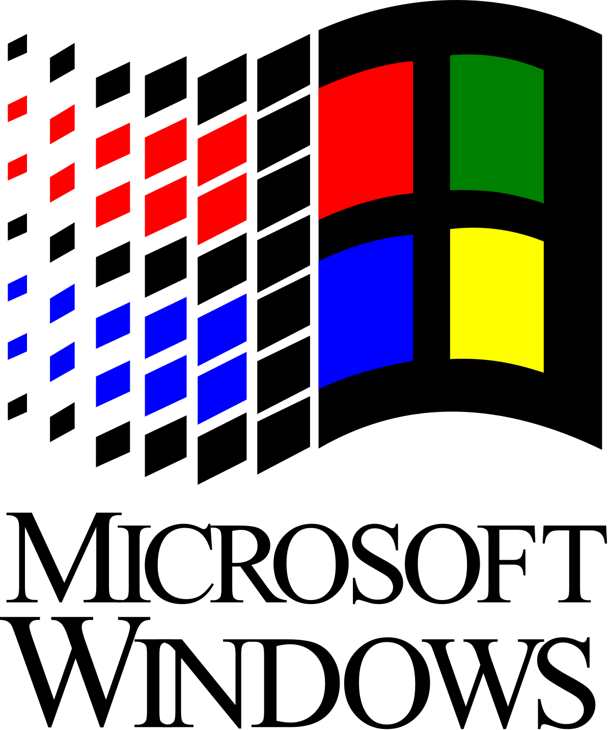
Windows 10
Welcome and enjoy

Slide 2
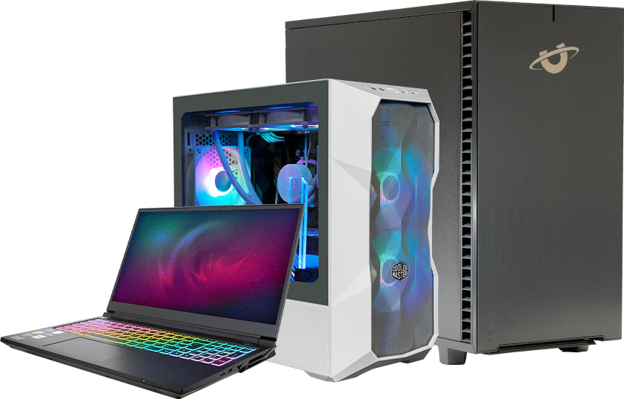

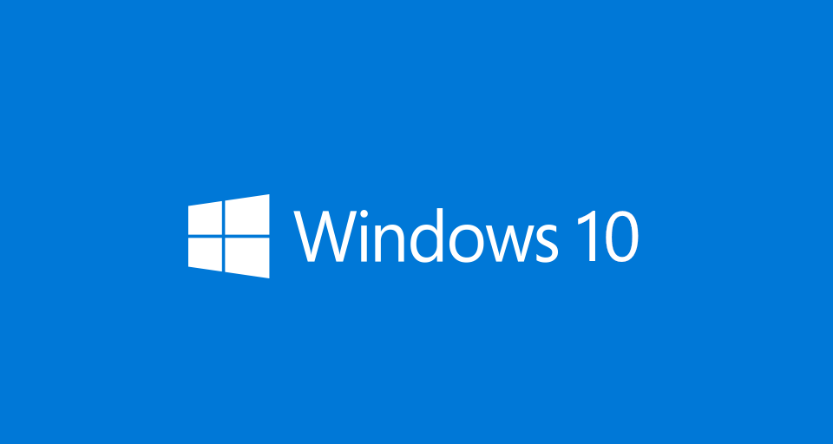
Market validation
Companies make computers and cellphones.
Public and private schools.
10,000,000 users

Slide 3

Problem
Open code
Malware-prone
Require much space (40gb)

Slide 4

Solution slide
Save money with the promotions
Antivirus
Harwdare compatibility
Software compatibility

Slide 5

Market size TAM
1+ billion of buys in 3 years
2+ billion of downloads not premium

Slide 6
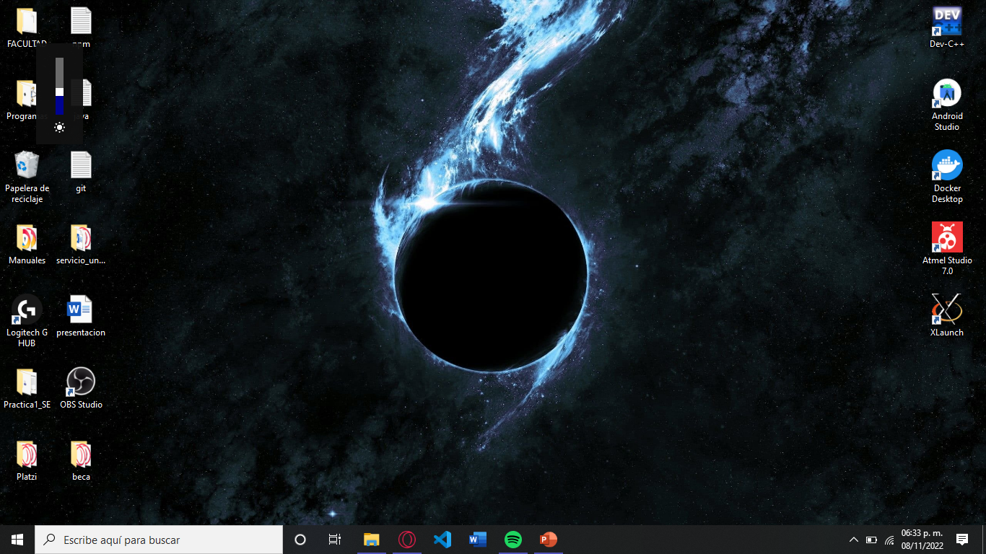
Product

Slide 7
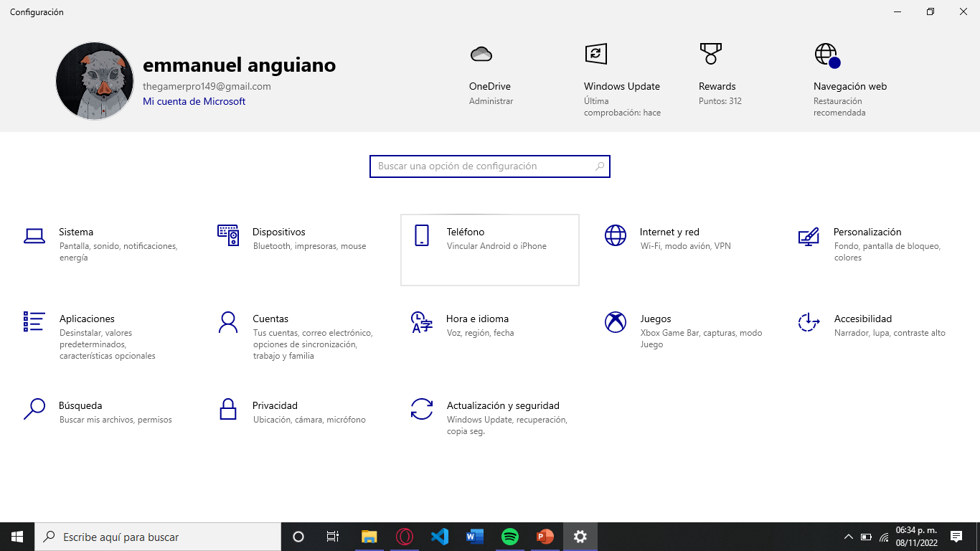

Slide 8



Business model
Partnerships:
HP
Lenovo
Samsumg
Events:
December fest
Talk with developers

Slide 9

Competition
Linux
IOS
Android
Solaris

Slide 10
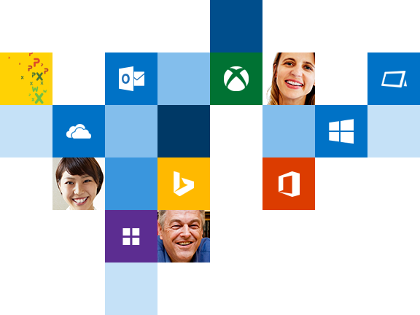
Competitive Advantages
Compatibble with any program
Easy to use (User Interface)
Uptadates without cost
Office and McAFee

Slide 11

Team
Alexander Zing, Backend developer
Jorge Briseño, Backend developer
Emmanuel Anguiano, User Interface
Enrique Jacobo, Marketer
Jimena Ahumada, Finance manager

Slide 12




